Slide 1
Changes to be made
Program title on the starting page changed to
Sensor Quality Detection Program for Eastern Shore Area
On the analysis page, provide an option for the user to decide whether to specify a time range
If the user choose to specify one, allow them to input a time range and use this to compute missing data
If the user choose not to specify one, use the current method
‘Select Sensor data CSV files’ changed to
Select a sensor data CSV file
Use a new page to show the analysis result

Slide 2
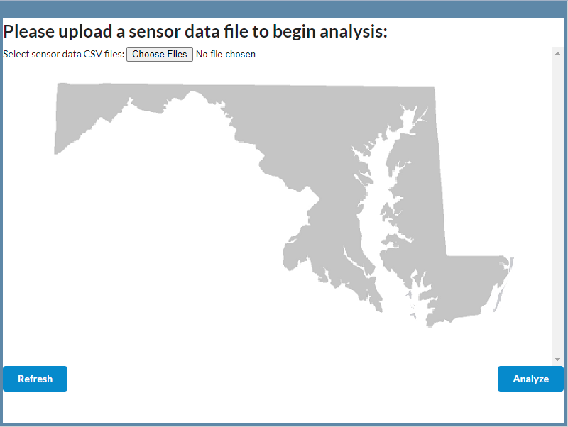
Evaluation results page
These two numbers might be different since the stages 2 and 3 should not include missing data
Evaluation summary
Zone ID: xxxxxx, Lane number: xx, Time frame: xx/xx/xx xx:xx-xx/xx/xx xx:xx, xxxxx recorded data
Evaluation results: (either conclusion)
Missing data: xx% (xxx/xxx recorded data)
Intervals with missing or faulty data
 | Peak hour | Off-peak hour
Congested day | Xx.xx% | Xx.xx%
Non-congested day | Xx.xx% | Xx.xx%
xx/xx/xxxx xx:xx, missing
xx/xx/xxxx xx:xx, volume too high
xx/xx/xxxx xx:xx, speed too high
xx/xx/xxxx xx:xx, violating Q-V relation
…
…
…
Faulty data: xx% (xxx/xxx recorded data)
This includes both stages 2 and 3.
 | Peak hour | Off-peak hour
Congested day | Xx.xx% | Xx.xx%
Non-congested day | Xx.xx% | Xx.xx%
Back

